Slide 1


Conquering Super Mario with RL strategies.
7111064803 張昆湧 Mario/マリオ
7111064109 林軒宇 Luigi/ルイージ
4108064040 鄭宇辰 Toad/キノピオ
4108064005 盧弘毅 Yoshi/ヨッシー

Slide 2
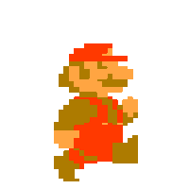
Proximal Policy Optimization Algorithms
Proximal Policy Optimization Algorithms

Slide 3
THANK YOU MARIO
YOUR QUEST IS OVER
WE PRESENT YOU A NEW QUEST
PUSH BUTTON B
TO SELECT A WORLD
THANK YOU MARIO
YOUR QUEST IS OVER
WE PRESENT YOU A NEW QUEST
PUSH BUTTON B
TO SELECT A WORLD

Slide 4
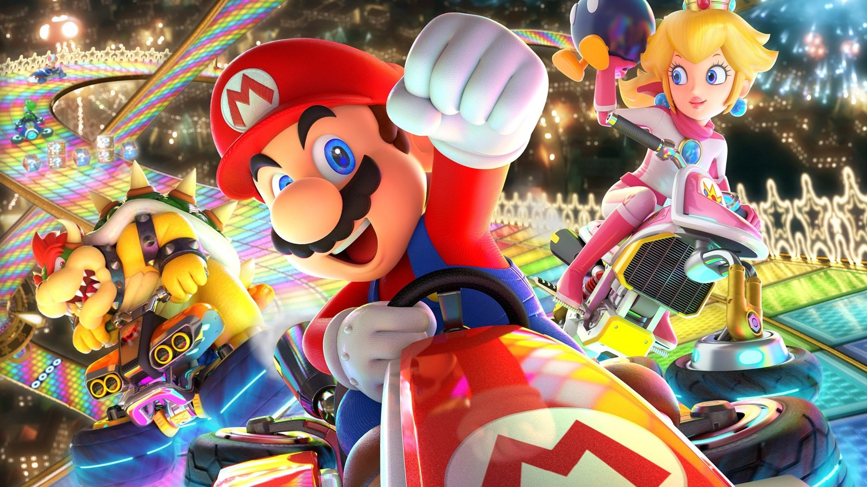
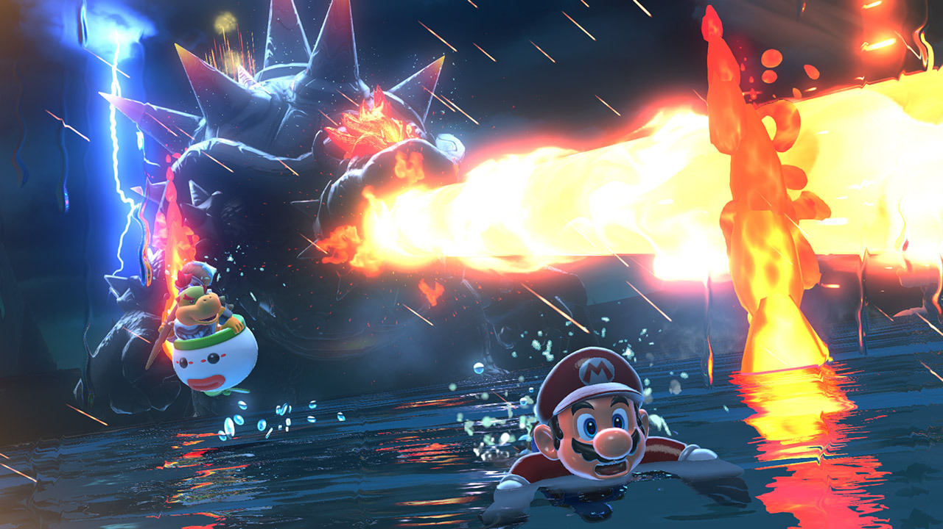
MARIO KART
MARIO PARTY
MARIO KART
MARIO FURY WORLD
SUPER MARIO MAKER

Slide 5
Double Deep Q-Network

Slide 6
AGENDA
Overview
Environment
Agent
Result

Slide 7
Library Setup
PyTorch Tutorials > Train a Mario-playing RL Agent
gym-super-mario-bros==7.4.0
Import necessary library

Slide 8
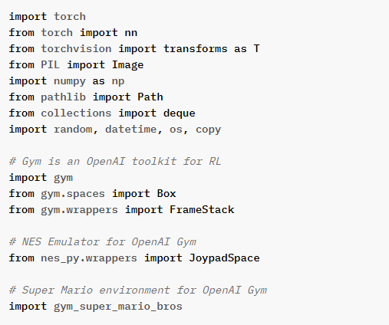

Slide 9
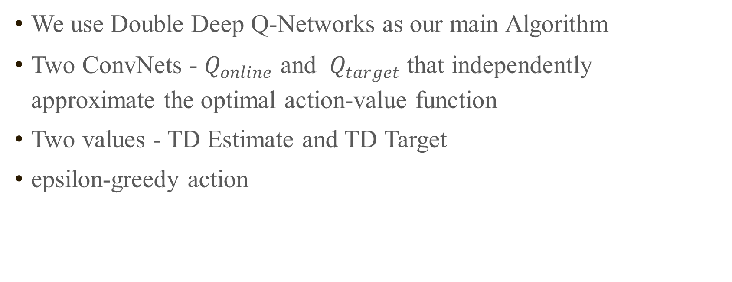
OVERVIEW
We use Double Deep Q-Networks as our main Algorithm
Two ConvNets - $Q_{online}$​ and $Q_{target}$that ​independently approximate the optimal action-value function
Two values - TD Estimate and TD Target
epsilon-greedy action

Slide 10
AGENDA
Overview
Environment
Agent
Result

Slide 11
Environment
env = gym_super_mario_bros.make
env = JoypadSpace(env, [["right"], ["right", "A"]])
env = GrayScaleObservation(env)
env = ResizeObservation(env, shape=84)
env = SkipFrame(env, skip=4)
env = FrameStack(env, num_stack=4, new_step_api=True)
[240, 256, 3] → [240, 256, 1]
[240, 256, 1] → [84, 84, 1]
[84, 84, 1] → [4, 84, 84, 1]

Slide 12
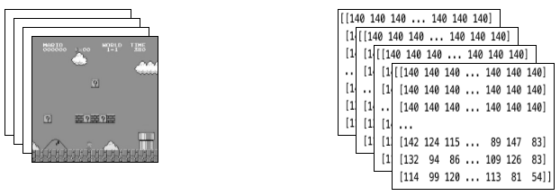
Environment

Slide 13
AGENDA
Agent
Act
Memory
Learn
Overview
Environment
Agent
Result

Slide 14
Epsilon-greedy action
# EXPLORE
if np.random.rand() < self.exploration_rate:
action_idx = np.random.randint(self.action_dim)
# EXPLOIT
else:
action_values = self.net(state)
action_idx = torch.argmax(action_values, axis=1).item()
# decrease exploration_rate
self.exploration_rate *= self.exploration_rate_decay
# we still set a min probability for exploration
self.exploration_rate = max(
self.exploration_rate_min, self.exploration_rate)
mini CNN structure
input -> (conv2d + relu) x 3 -> flatten
-> (dense + relu) x 2 -> output

Slide 15
Memory
# cache(self, state, next_state, action, reward, done)
state = torch.tensor(state, device=self.device)
next_state = torch.tensor(next_state, device=self.device)
action = torch.tensor([action], device=self.device)
reward = torch.tensor([reward], device=self.device)
done = torch.tensor([done], device=self.device)
self.memory.append((state, next_state, action, reward, done,))
# recall
batch = random.sample(
self.memory, self.batch_size) # just sample in normal distribution
state, next_state, action, reward, done = map(torch.stack, zip(*batch))

Slide 16
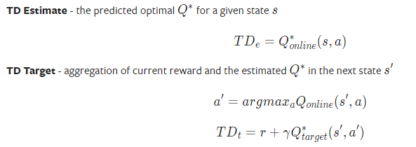
learn
# Sample from memory
state, next_state, action, reward, done = self.recall()
# Get TD Estimate
td_est = self.td_estimate(state, action)
# Get TD Target
td_tgt = self.td_target(reward, next_state, done)
# Backpropagate loss through Q_online
loss = self.update_Q_online(td_est, td_tgt)

Slide 17
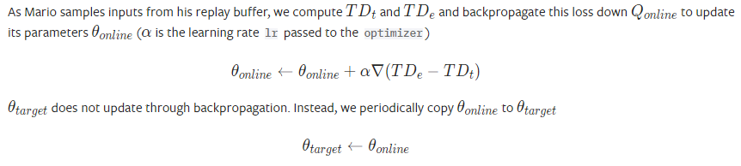
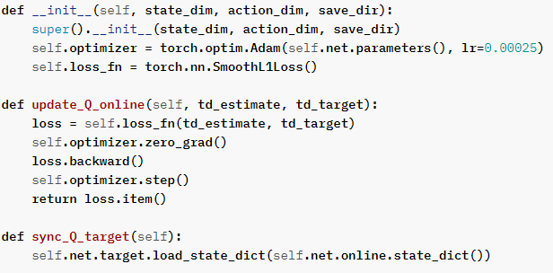

Slide 18
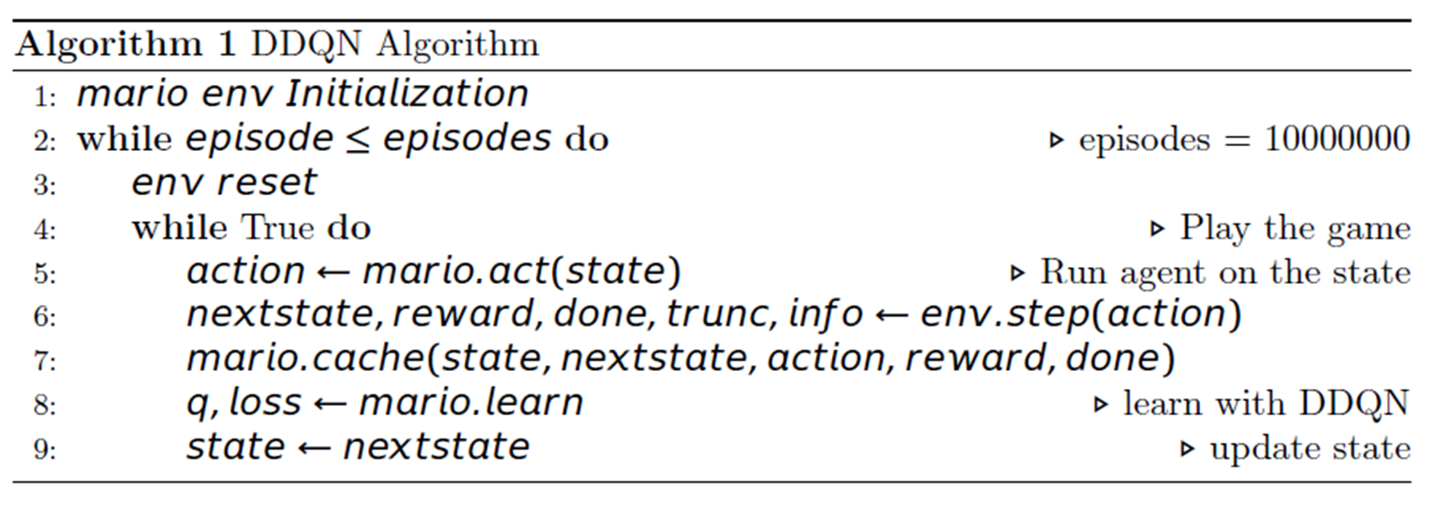
Small Conclusion

Slide 19
AGENDA
Overview
Environment
Agent
Result

Slide 20
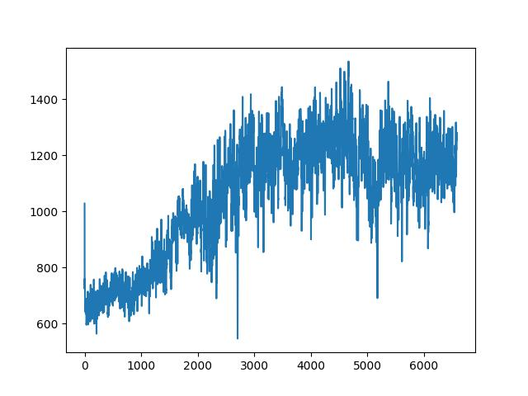
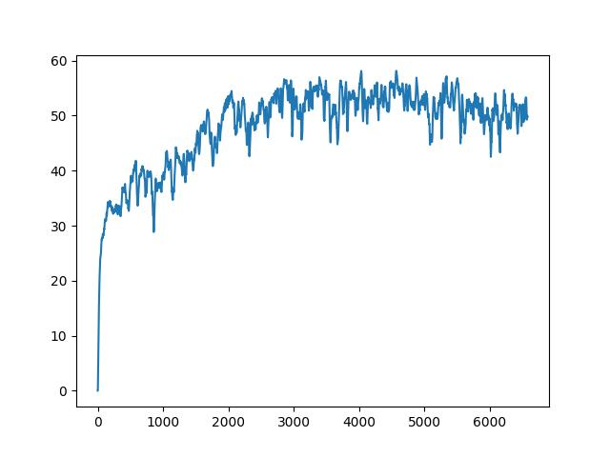
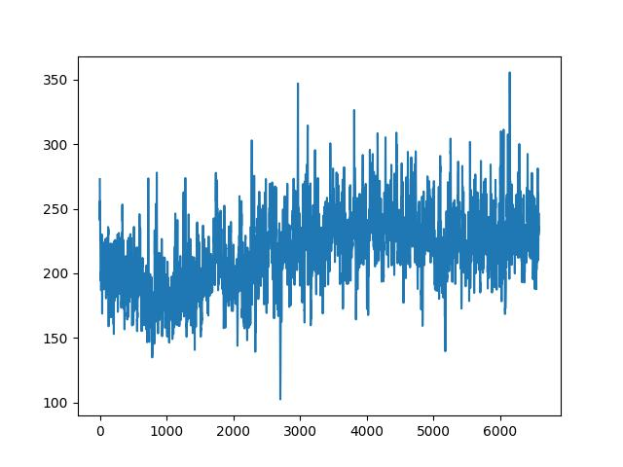
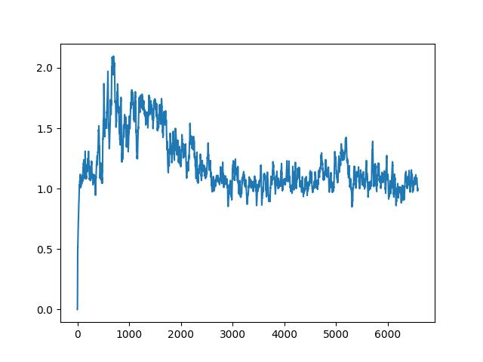
Reward
q_plot
length
loss_plot

Slide 21


500000 steps
3500000 steps

Slide 22


COMING SOON

